Slide 1


Driving Business Impact through Purposeful Communication​​

Slide 2

01
Today’s Destination
Issue Based Problem Solving and Communication
Hypothesis Based Problem Solving and Communication
Emotional Intelligence in Communication
1
2
3
Storyline Development and Communication
Presenting Industry
Insights and PoV
Mid Term
5
4
Exam
The Art of Effective Negotiation in Corporate
End Term
6
Exam

Slide 3
02
Mid Term Simulation
Personality
“Who you are”
Interface Between
Emotional Quotient
“How Aware you are of your Emotional Makeup”
Communication
“What is your communication style? “

Slide 4
What is the Task for Today? (1/2)
03
Task 1
You’ll be given a Personality Test, which you’ll take in the next 30 minutes. It has 70 items and you are supposed to take it in one go.
Once you submit the test, a Report will be generated that analyses your personality traits, your tendencies and work behaviour. It will be a detailed outline of your strong and weak areas, across 4 parameters – Work Management, People Management, Self Management and Change Management.
We’ll tell you how to read your report.

Slide 5
Lets Take the Test!
04
You shall respond to 70 statement-based questions that assess the personality traits that are most true to yourself.
Please ensure you answer all questions for an honest, accurate and valid evaluation of your personality - as the competencies in your report are important for a preliminary analysis.
The overall diagnostic will take you about 25-30 minutes to complete.
Once you submit/complete your responses, close the test and wait. You will receive your report both in an HTML and a PDF format on email. Download the PDF and read through.

Slide 6
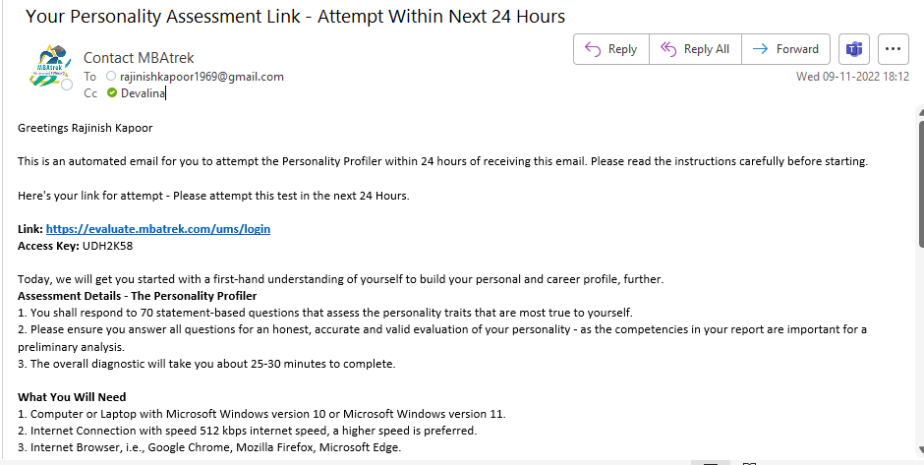
Step 1
05
Please check your email – titled – “Your Personality Assessment Link - Attempt Within Next 24 Hours”. If your inbox does not have the email, please look in your Junk/Spam folder. The email might have gone to your junk folder by mistake – please move it to your inbox. You will receive this email from contact@mbatrek.com.

Slide 7

Step 2
06
Take the assessment by clicking on Link – in the email. Below that is given your unique answer key. Please make sure you read the instructions carefully before taking the assessment. The email will have a Link and an Access Key. Please note: The access key in your email is unique to you, please do not share it with others, it won’t work for them.

Slide 8
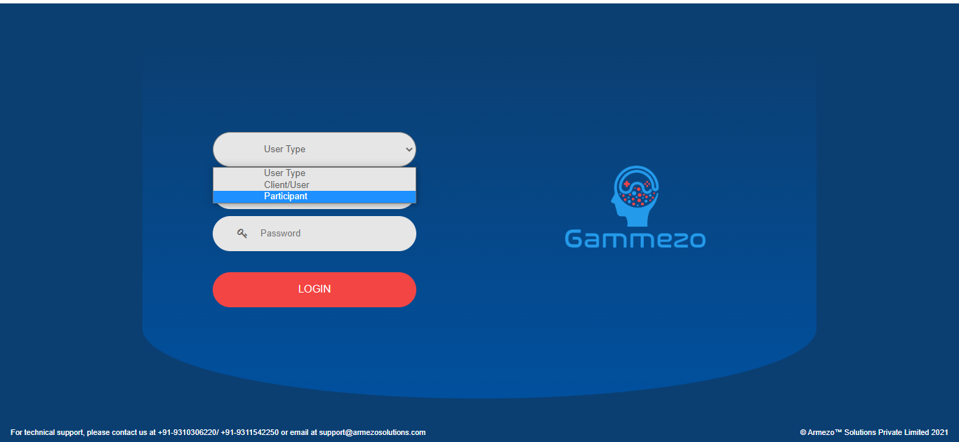
Step 3
07
On clicking on the “Link” – it will take you to the assessment page. Select user type as ‘Participant’.

Slide 9
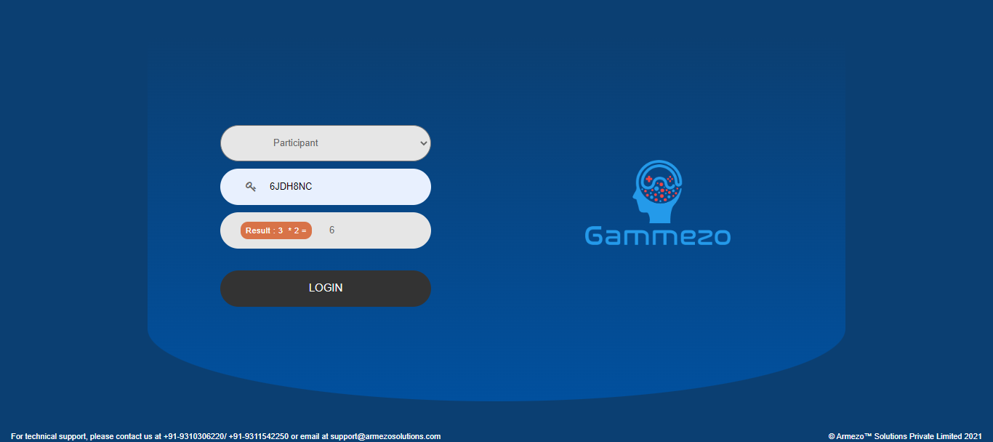
Step 4
08
Fill in your access key correctly – please remember, this access key can be used only once and is unique to your link of attempt. It will also ask you for a quick mathematical calculation for verification. Login to proceed.

Slide 10
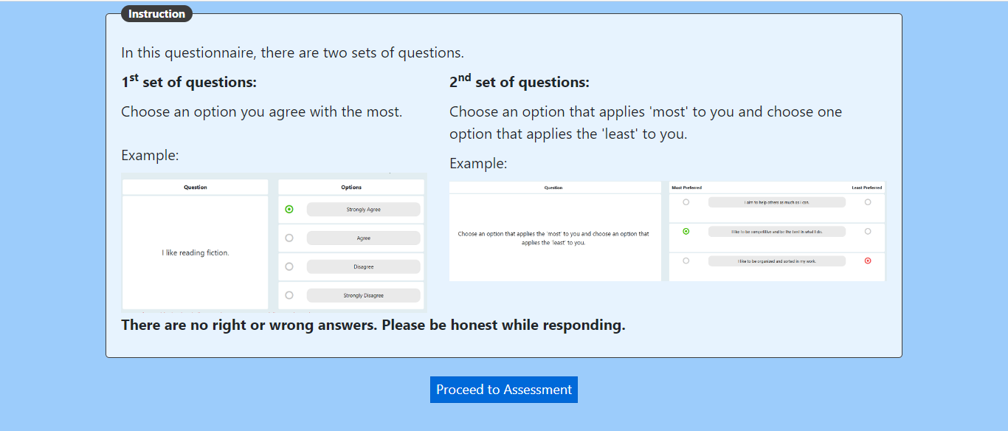
Step 5
09
Fill in your details – Name, email id, phone number and date of birth. Read the instructions carefully and take the test. Please complete the test once you start and do not close it without completing all questions – attempt all the questions. There will be 2 types of questions asked – please read the question carefully and answer it. This assessment is about your personality – answer accordingly. There is right/wrong answer.

Slide 11
10
Done with the Test?
Let’s look at the Report!

Slide 12
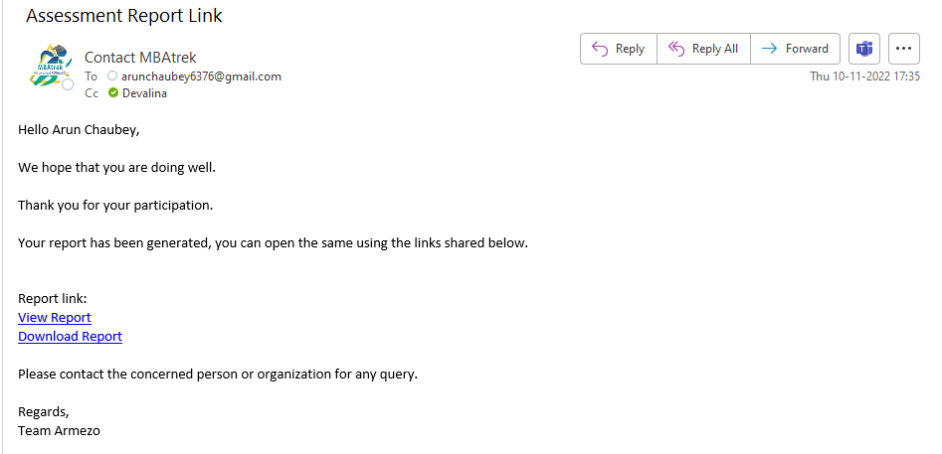
Check Your Inbox for your Report

Slide 13
What is the Task for Today? (2/2)
11
Task 2
On the basis of your understanding of your report, build 2 Trees –
1) Issue Tree for Weakest Area
2) Hypothesis Tree for Strongest Area
The trees should branch out and identify causes and sub-causes of -
“How a particular personal attribute came about to become your strongest/ weakest area?”
The tree must be branched to at least 3 levels.

Slide 14
Your Deliverables
12
Prepare a PowerPoint presentation of 2 slides, consisting of 1 Issue Tree and 1 hypothesis Tree.
Submission : Upload it on your LMS > Assignment Section > Mid Term.
Please Note: Please make your slides and submit it in the time given, here in class! No submission will be entertained over email later.

Slide 15
Template Issue Tree
13
Level 1
Level 2
Level 3
Weakest Area : Taking Initiative
Notes:
ISSUE TREES VS. HYPOTHESIS TREES
Issue Tree Analysis
Issue trees identify all potential ideas
Issue trees ask “How” we could meet a desired outcome
Issue trees are excellent for organizing ideas in a “MECE” manner
Complete issue trees uncover all potential ideas
Hypothesis Tree Analysis
Hypothesis trees focus and build up an argument or conclusion
Hypothesis trees ask “Why” we believe something to be true
Hypothesis trees are excellent for narrowing down investigation to essentials
Complete hypothesis trees build up a complete argument
Hypothesis trees focus on the “so what” of any data that is presented

Slide 16
Template Hypothesis Tree
14
Level 1
Level 2
Level 3
Strongest Area :
Assertiveness
Notes:
ISSUE TREES VS. HYPOTHESIS TREES
Issue Tree Analysis
Issue trees identify all potential ideas
Issue trees ask “How” we could meet a desired outcome
Issue trees are excellent for organizing ideas in a “MECE” manner
Complete issue trees uncover all potential ideas
Hypothesis Tree Analysis
Hypothesis trees focus and build up an argument or conclusion
Hypothesis trees ask “Why” we believe something to be true
Hypothesis trees are excellent for narrowing down investigation to essentials
Complete hypothesis trees build up a complete argument
Hypothesis trees focus on the “so what” of any data that is presented

Slide 17
15
Evaluation Criteria
Emotional Intelligence reflected as Self Awareness in introspecting one’s strongest and weakest areas.
Clarity in thought and expression while identifying the causes and sub causes.
Structured thought process in breaking down any issue into issue/ hypothesis tree.
Notes:
Creating greater impact & achieve outcomes you want
Highly effective leadership
Building trustful relationships

Slide 18
16
Let’s Get the Dice Rolling !!!

